Slide 1
Display Materials

Slide 2
Rainfed area
by crop
Irrigated
area by crop
Shipping
by crop, route
Pumping
Precipitation
Domestic Demand
Agriculture
Transportation
Cultivation < Area
Demanded
Irrigation
Produced
Trade balance
Conjunctive Use
Market
International
Sales
SW Demand
Available > 0
Domestic Sales <
Domestic Demand
Domestic Sales
Water Network
Withdrawals
Runoff
Withdrawals > SW Demand
Modified flows > 0

Slide 3
Optimization setup
Minimum set of variables for linear optimization
Optimization Parameters | Constraint Variables

Slide 4
Domestic Demand
0.575 m³ per capita, per day
(Hoekstra & Chapagain, 2006)
Currently must be provided (constraint)
Parameters:
Equations:

Slide 5
Agriculture
Statistical GDD/NDI model of yields, with spatial variation and model extrapolation
Optimized parameters: irrigated and rainfed areas by crop, region, period
Currently, only 1 crop per year
Determines unit area water deficit in each county
Rainfed areas have no water demand, and get the full water deficit; irrigated areas take additional water to have 0 water deficit.

Slide 6
Agriculture Equations
Parameters
Equations:

Slide 7
Transportation
Handles the movement of resources (crops) from one area to another.
Crops move along county-neighbor network, approximating roads.
Optimized parameters: imports along each link, translated into total imports and exports by resource for each county.
NB: imports not informed by crop availability; depends on market available constraint.

Slide 8
Transportation equations
Parameters:
Equations:

Slide 9
Conjunctive Use
Combines all water demands (domestic and irrigated)
Optimized parameter: rate of pumping
Determines surface and groundwater extraction
NB: water extraction not informed by availability; depends on Water Network constraint.

Slide 10
Conjunctive Use Equations
Parameters:
Equations:

Slide 11
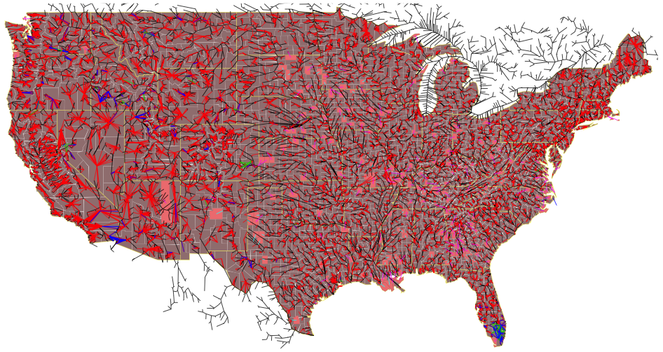
Water Network
Nodes represent USGS gauges, reservoirs, canals, and junctions.
Counties linked to 1 or more nodes for extraction and taking runoff.
At each node, water added by runoff, removed by county demands, and flows downstream.

Slide 12
Water Network equations
Parameters:
Equations:

Slide 13
Market
The market determines the total availability of each resource in each region, given production, imports, and exports.
Up to a given demand, available resources are sold at a higher domestic price; any additional resources are sold at an international price.

Slide 14
Market equations
Parameters:
Equations:

Slide 15
Optimization
Domestic and international revenues from sales of crops, minus transport costs and pumping costs.

